Slide 1



Graham Martin, Chairman and CEO

Slide 2


The Opportunity
Your Opportunities
User Benefits
Who We Are
What We Offer
Our Mission
Our Members
The EnOcean Wireless Standard
Smart Homes
Smart Building
Smart Spaces
Join Us
Thank you
Back-up Slides
A clear Vision
Technical Cooperation
Marketing Cooperation
No Limits Application
The Building Revolution

Slide 3
The Opportunity
80% Energy / CO₂ Reduction by 2050
To Make our Buildings Energy & Cost Efficient, Comfortable, Sustainable and Secure:
Buildings Use 40% of our Energy Requirements
Billions of Connected Sensors Required
Cost Savings / Optimization
No Wires, no Batteries Necessary
Flexibility
Maintenance Free over Decades
Health & Wellness Focus
Multi-Vendor Interoperability
Optimized Energy Savings Require Sensor Data
Ease of Installation and Operation
On Demand & Sharing Society

Slide 4

Your Opportunities
Retrofit of millions of buildings in the next 5 years – tens of millions by 2050
New commercial buildings require building automation based on open standards
All new buildings according to strict energy / emissions laws
Smart homes with interoperable open systems: comfort, security, efficiency
Legislation Examples - EPBD2024, GEG 2024, Inflation Reduction Act, NYC Local Law 97, Title 24, RE2020 / BACs decree.

Slide 5

Your Opportunities
Tailwind for Energy Harvesting Wireless Solutions
  Major organizations / standards 3GPP (5G, 6G), IEEE, Bluetooth huge promotion starting
    Less than 10% of current automation installations use wireless sensors
  Wired solutions 30% more expensive, inflexible, huge strain on natural resources (Copper, Plastic)
  Battery operated wireless solutions need maintenance, huge strain on natural resources (Lithium)

Slide 6

User Benefits
Construction Time & Costs
  savings up to 15% in new builds, 80% in retrofits
  Interoperable eco-system with multiple vendor choices
Health & Wellness
  15% employee motivation & productivity increase
Space Optimization
  25%-40% less space & running costs
Energy & CO₂ Savings
  30% typical in commercial environment
Sustainability / ESG
  maintenance free for decades

Slide 7




The EnOcean Alliance
The EnOcean Alliance is an international association of leading companies in the building and IT industries founded in 2008. The open, non-profit organization is committed to enabling and promoting interoperable eco-systems for Smart Homes, Smart Buildings and Smart Spaces based on the maintenance-free radio standard (ISO/IEC 14543-3-10/11).

Slide 8






What We Offer
Networking Eco-System
Smart Building and Smart Spaces players from sensor to cloud
Education
Marketing activities and promotion of members‘ solutions
Technical Specifications
Easy entry to existing large interoperable eco-system, shorter time to market
International open standard

Slide 9


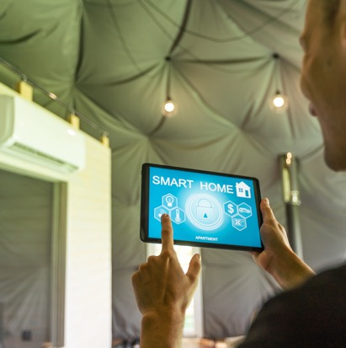


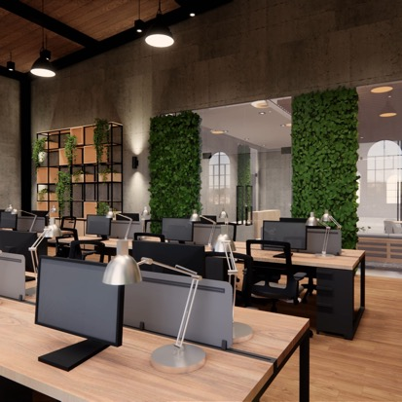
Our Mission
As a professional global network, the members of EnOcean Alliance co-create truly interoperable, maintenance-free and proven eco-systems based on the EnOcean radio standard. With our decades of experience we are committed to enabling a healthier, safer and sustainable environment in Smart Homes, Smart Buildings and Smart Spaces for the benefit of all.
400+ Members Creating Multi-vendor
Product Interoperability & Solutions
37 Countries
5.000+ Products
Proven Over 20 Years
25.000.000+
Products Installed

Slide 10
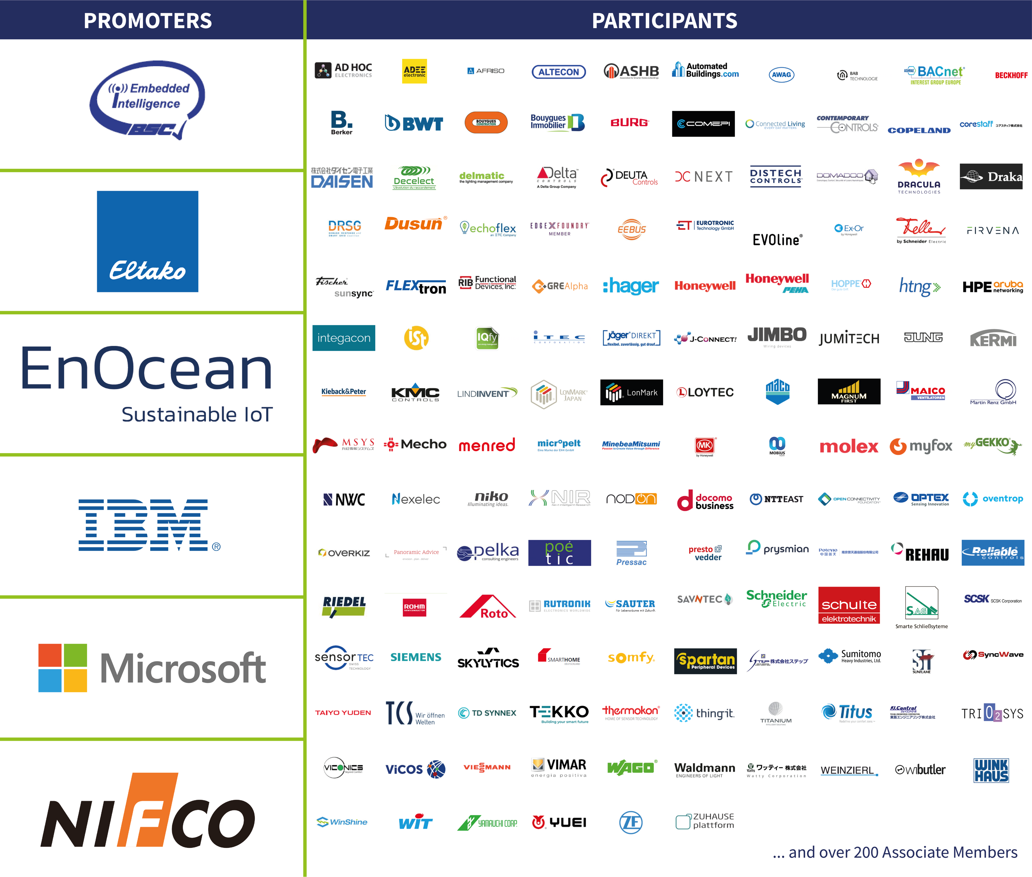
Our Members
A Vibrant Eco-System for Smart Homes, Smart Buildings and Smart Spaces

Slide 11



EnOcean – Powered by
Energy Harvesting
The EnOcean Wireless Standard
(ISO/IEC 14543-3-10/11) is geared to wireless sensors with ultra-low power consumption allowing energy harvesting power -e.g. from motion, light or temperature differences – or ultra-long battery lifetime.
This principle enables battery- and maintenance-free electronic control systems.
The EnOcean Wireless Standard
in sub-1GHz has been developed and optimized for use in buildings,
maximum range (30m indoors) & minimum interference
Europe, China, others
North America
Japan, Australia

Slide 12


Smart Homes
EnOcean Solutions Increase Comfort & Security
  Ease of Planning, Installation & Operation
  Interoperable Products from Multiple Suppliers (international standard)
  No Battery Failure / No Maintenance
  Seamless Interfaces to Multiple Smart Home Standards and Devices
  Proven: EnOcean Technology Installed in 1.000.000+ Buildings (e.g. Homes, Ambient Assisted Living Locations, Social Housing and Apartments)

Slide 13
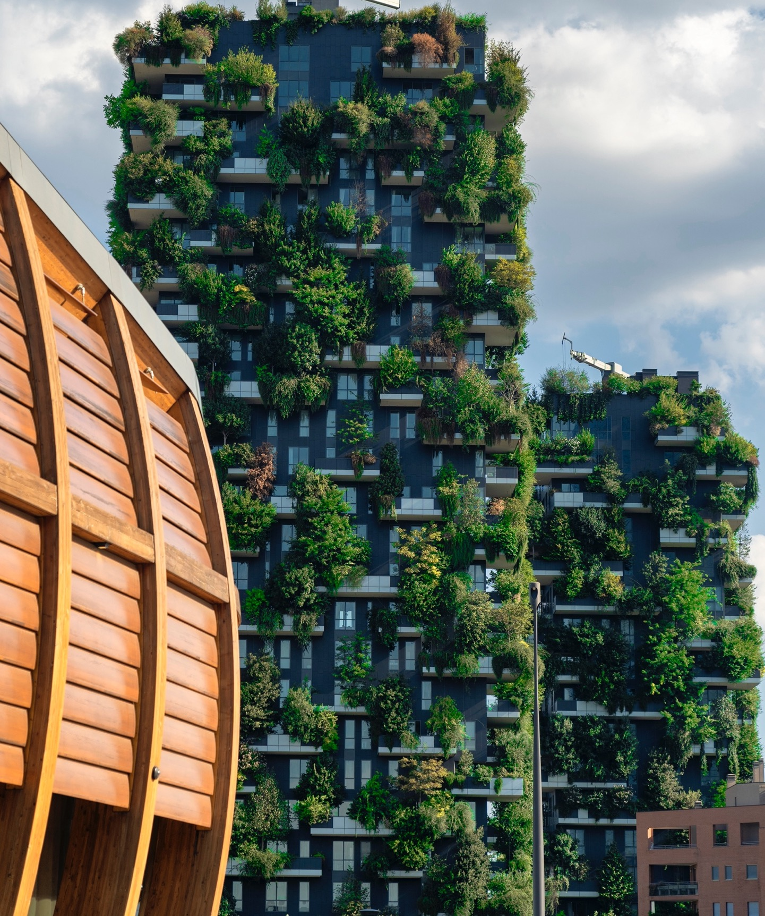
Smart Buildings
Self-powered Wireless Switches, Sensors and Controls cut Installation Cost and Time, and enable efficient Use of Energy
  Energy & CO₂ Savings
  Increased Health & Wellness (Comfort)
  Ease of Planning, Installation & Operation
  Interoperable Products from Multiple Suppliers (international standard)
  No Battery Failure / No Maintenance
  Seamless Interface to Building Management Systems and Cloud Solutions
  Proven: EnOcean Technology Installed in 1.000.000+ Buildings (e.g. Offices, Schools, Hotels, Hospitals, Industrial, Historical Buildings and Retail)

Slide 14


Smart Spaces
Maintenance-free EnOcean solutions
  Ease of Installation & Operation (especially in retrofit scenarios)
  Interoperable Products from Multiple Suppliers (international standard)
  Seamless Interfaces to IT infrastructure, BMS and Cloud Solutions
  Space & Energy Utilization Optimization (office, desks, conference rooms, areas)
  Health & Wellness (servicing / cleaning on demand, occupancy, air quality)
  Proven: EnOcean Technology Installed in 1.000.000+ Buildings (e.g. Offices, Schools, Hotels, Hospitals, Industrial, Historical Buildings and Retail)

Slide 15






Join Us
The EnOcean Alliance has grown to more than 400 members since its foundation in 2008. Our Board of Directors unites representatives of leading international solution providers in the areas of Smart Homes, Smart Buildings and Smart Spaces.
EnOcean Alliance members benefit from immediate access to a vibrant, interoperable eco-system offering solutions, products and services, creating new business opportunities.
www.enocean-alliance.org
youtube.com/c/EnOcean-Alliance
linkedin.com/company/enoceanalliance
instagram.com/enocean.alliance
facebook.com/EnOceanAlliance
x.com/EnOceanAlliance

Slide 16

Thank you for your attention!
Contact
For further information please feel free to contact us
Graham Martin
graham.martin@enocean-alliance.org
EnOcean Alliance
5000 Executive Parkway, Suite 302
San Ramon, CA 94583, USA
Phone US: +1 (925) 275-6601
help@enocean-alliance.org
www.enocean-alliance.org

Slide 17


Back-up Slides

Slide 18



A clear vision
We want to create a healthier, safer and environmentally
friendly world by utilizing the infinite potential of our energy harvesting based wireless standard interoperating with other global standards

Slide 19



Technical Cooperation
Engineers from member companies collaborate within our Technical Working Group to enhance and improve the EnOcean Standard.
Members have exclusive access to:
  Software & support to implement interoperable products based on Alliance Specifications
  Proposal of features and profiles for adoption in the standard
  Beta programs for new developments
  Unique Manufacturer ID for interoperable
  products

Slide 20


Marketing Collaboration
  Majority of members’ fees invested in marketing and networking activities
  Strong presence of members' products and solutions on EnOcean Alliance website
  Social Media Promotion (YouTube, X, Facebook, LinkedIn, Instagram, WeChat)
  Marketing & Training materials available to members
  Networking opportunities
  International trade fair/ events presence

Slide 21
No Limits Applications
Powered by Energy Harvesting,
the EnOcean Radio Standard offers infinite options for application – such as ...
Transportation
&
Logistics
Outdoor Monitoring
Industrial

Slide 22
The Building Revolution
We are changing the way we plan, construct and run buildings.
Energy
Efficient
Healthy
All buildings will be:
Sustainable
Connected
Offering Services and Sharing
Maintenance-free interoperable wireless solutions based on EnOcean open radio standard enable smarter connectivity, paving the way to the digital building revolution.

